Slide 1
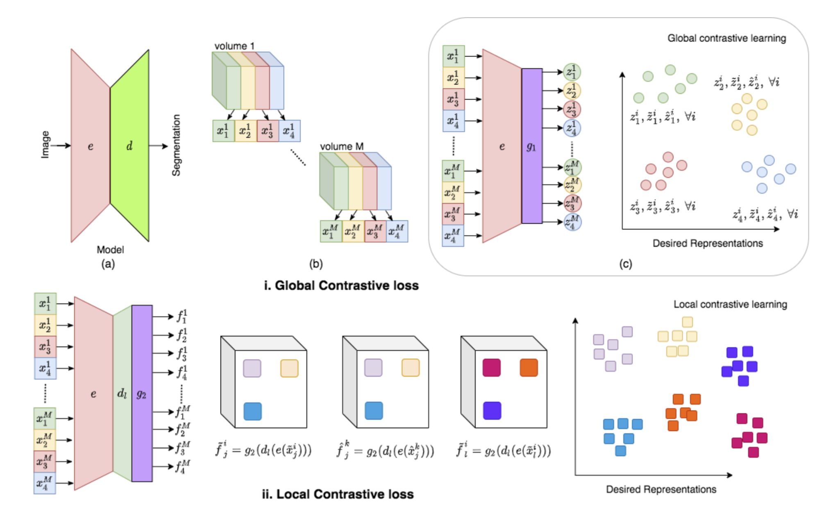
data from the same dataset
slices are roughly aligned within patients.
what sort of repsetnetatin of the output which maximize theMI and not senseible to the misalignment.
related work:
Global contrast + local contrast
Training processus:
pretrain encoder-> pretrain decoder->
finetuning all the network using small xtr and xvl
and report the values on a large test set.

Slide 2
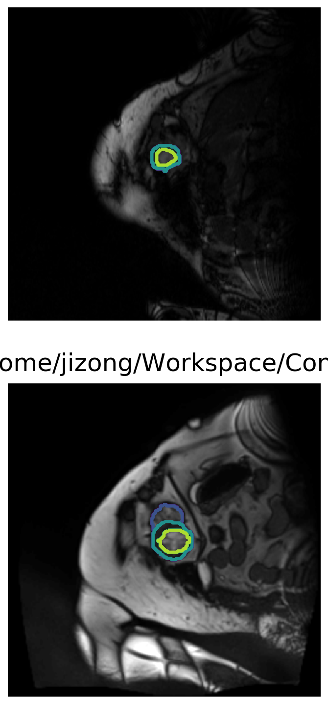
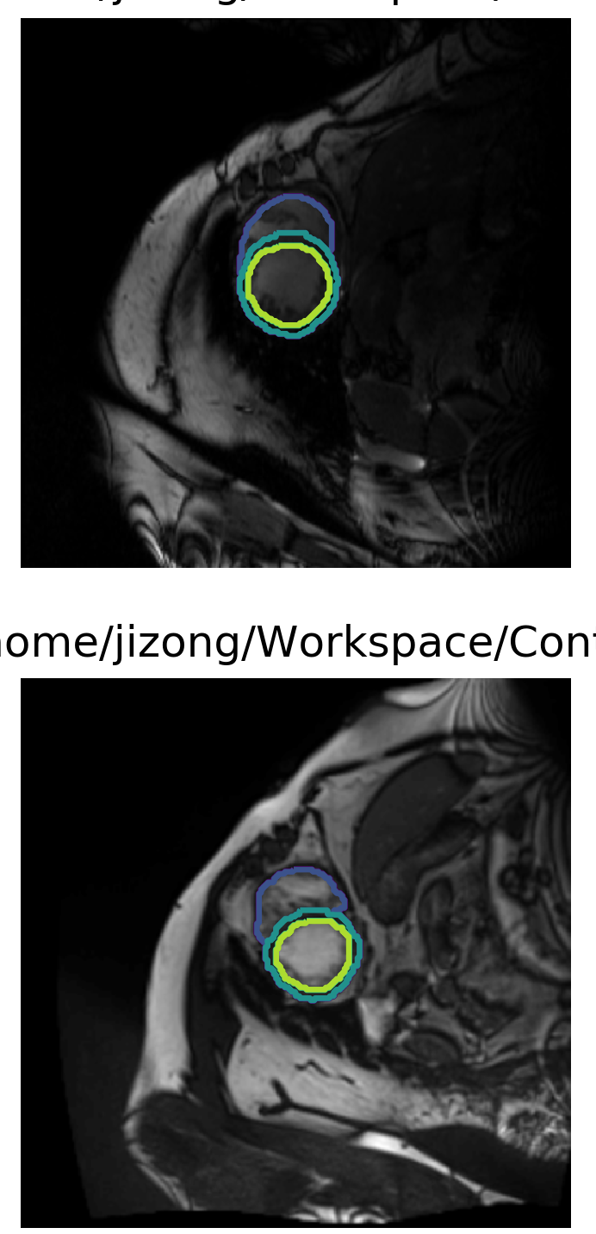
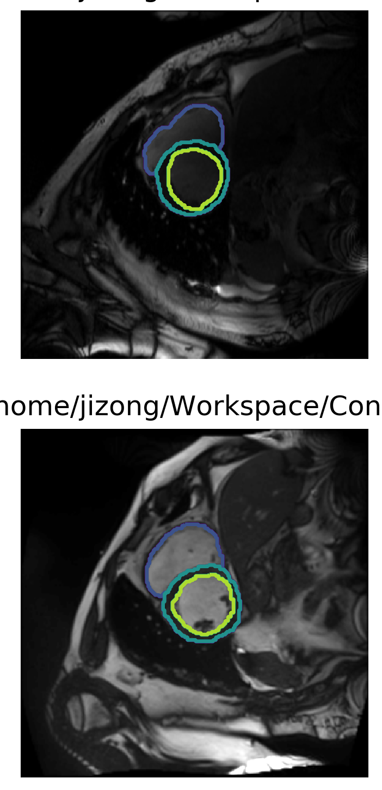
My progress:
1. we use ACDC dataset as the same as theirs.
Patient 1
Patient 2
Partition1
Partition2
Partition3

Slide 3
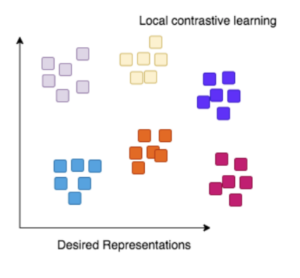

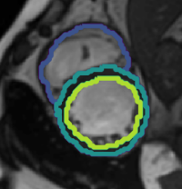
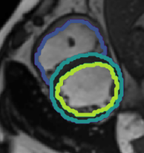
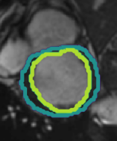

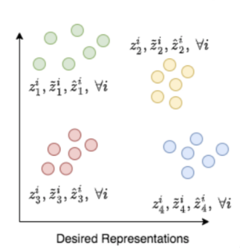
network architecture
d_{anc}
d_{pos}
d_{neg}
local contrast
encoder
anchor
anchor
positive
positive
negative
negative
e_{anc}
e_{pos}
e_{neg}
global contrast

Slide 4
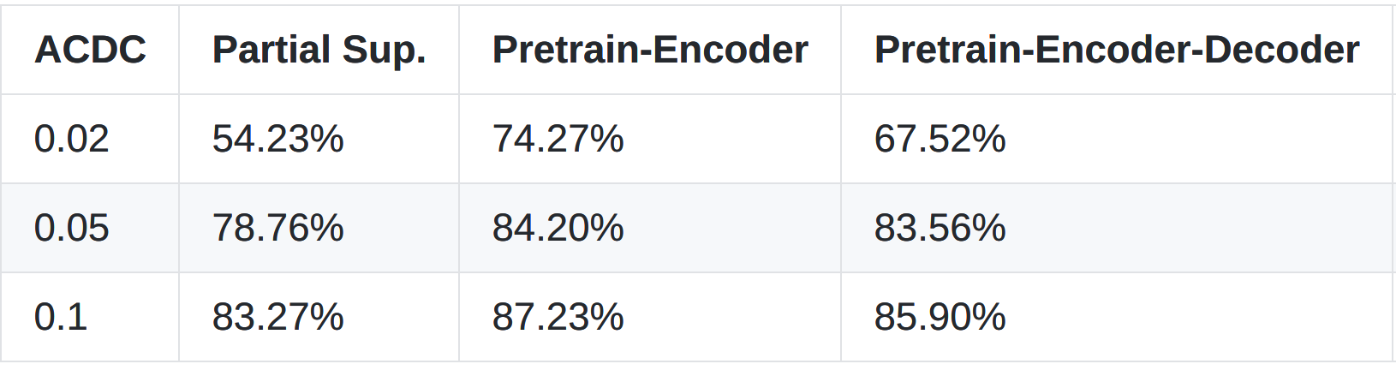
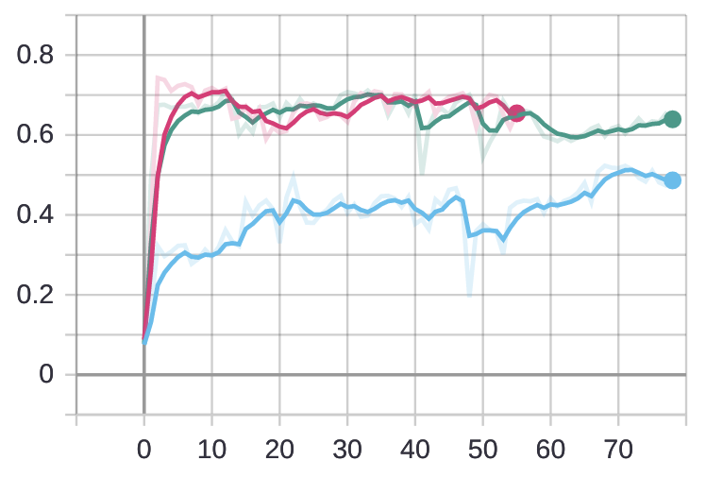
Baseline result
mean dice for the case 0.02
observations:
1. pretrain encoder is effective
2. decoder pretrain is not effective due to the unalignment
in the original paper, when training decoder, there is no positional move on images
3. IIC MI can be useful in this case.

Slide 5
Baseline result
Encoding using partition-wise contrastive
Encoding using patient-wise contrastive
to be continued

Slide 6
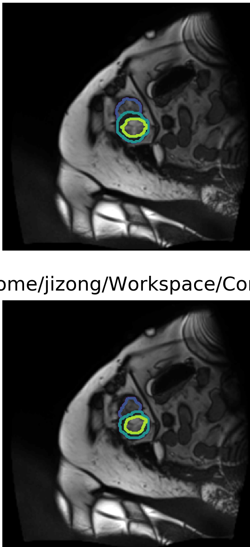
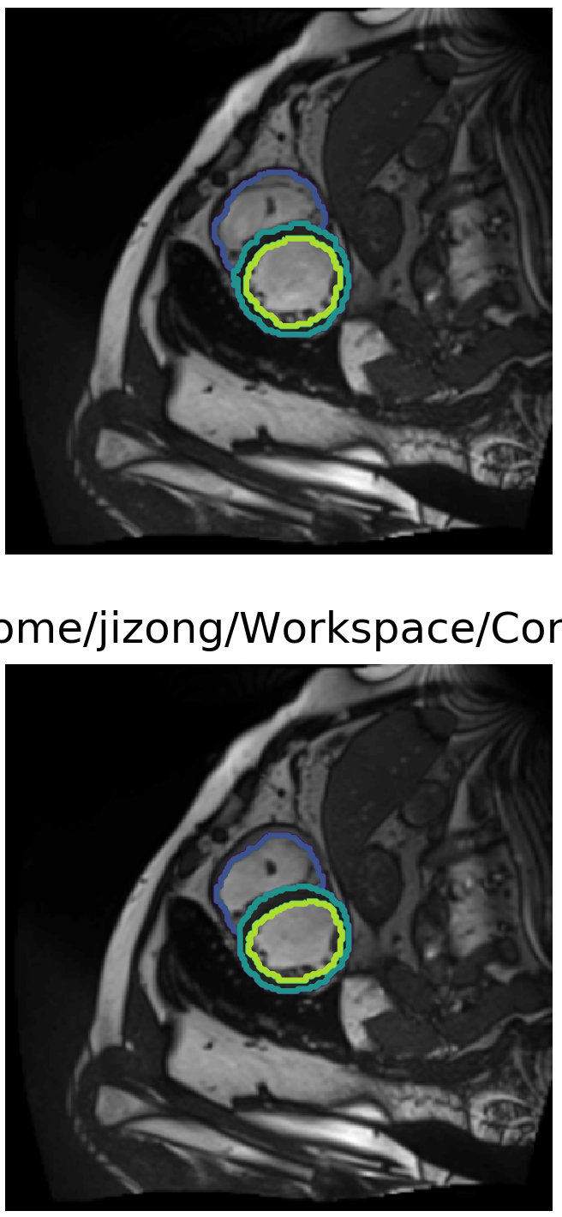
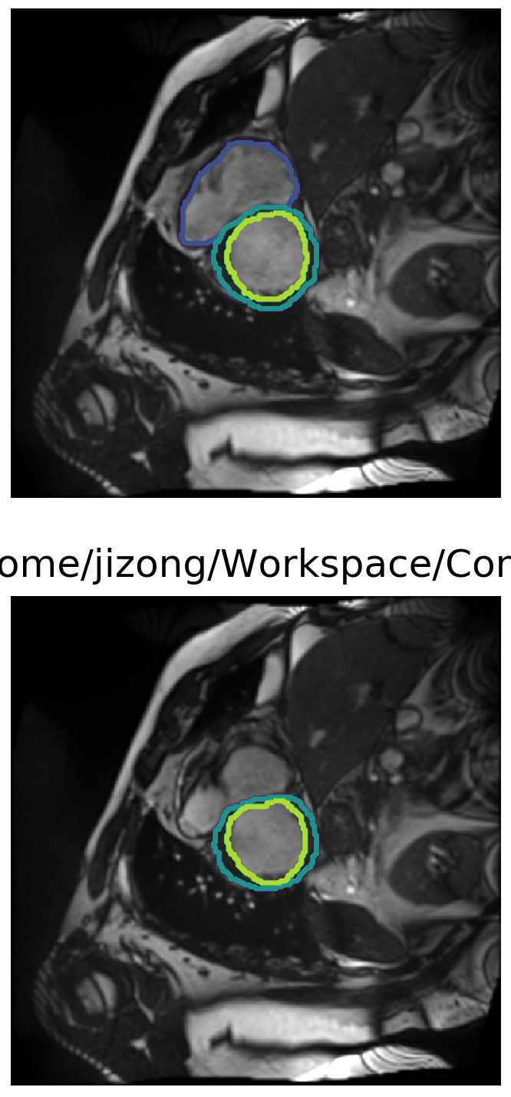
My progress:
1. we use ACDC dataset as the same as theirs.
Patient 1
ED phase
Patient 1
ES phase
Partition1
Partition2
Partition3

Slide 7




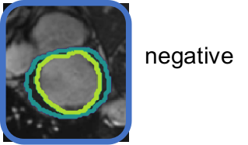
network architecture for IIC + bounding box?
IIC loss
anchor
anchor
IIC loss
IIC loss (discriminator)
From
other
modality
roughly
aligned
images
roughly
aligned
images
e_{anc}
e_{pos}
IIC loss (discriminator)??
negative
no loss here
e_{neg}
Enc_contrast

Slide 8
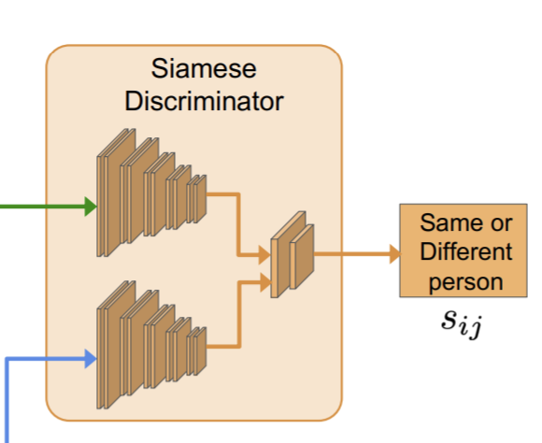
further steps
have a discriminator would help ?
Improve the learning strategy using IIC loss
Compared the different methods in `semi-supervised learning` instead of `pretrain-finetuning`: because

Slide 9
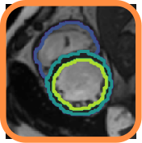

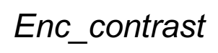



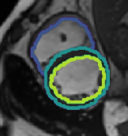
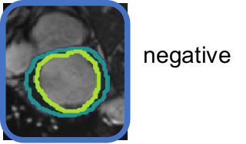
Encoder part
projection
head
e_{anc}
e_{pos}
e_{neg}
positive
Total_loss
normalized features
with reduced dim
p_{anc}
IIC_contrast
p_{pos}
p_{neg}
intemediate
features
projection
classifier

Slide 10
Encoder part
projection
head
e_{anc}
e_{pos}
e_{neg}
positive
Total_loss
normalized features
with reduced dim
p_{anc}
IIC_contrast
p_{pos}
Temperature: T
p_{neg}
num_clusters: N
intemediate
features
projection
classifier

Slide 11
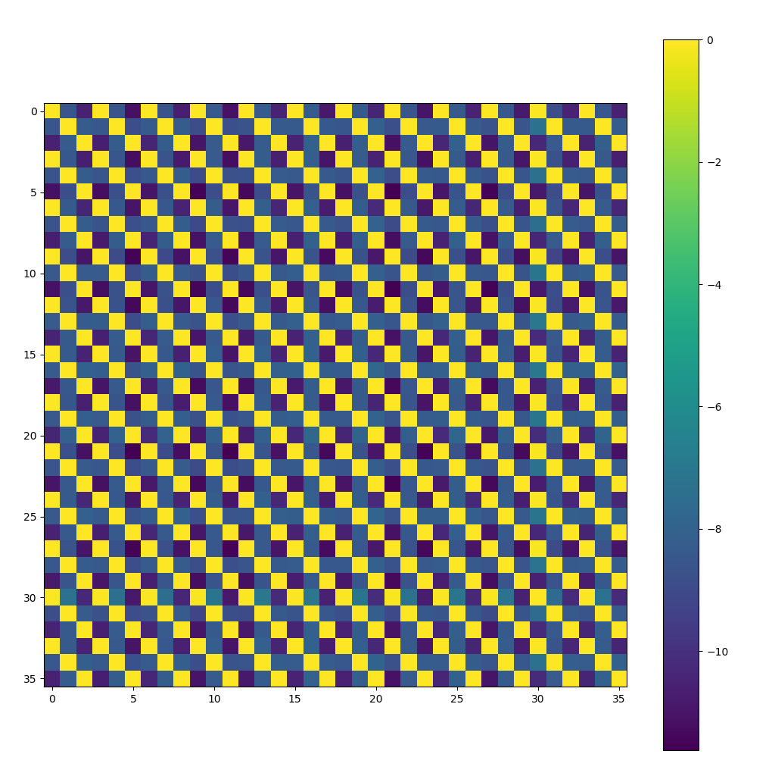
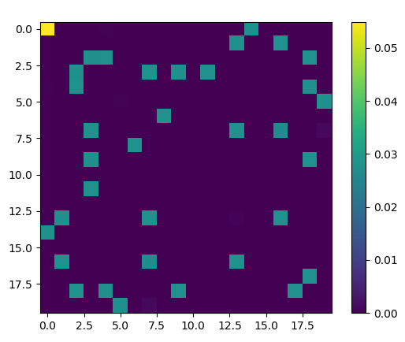
Encoder part
projection
head
e_{anc}
e_{pos}
e_{neg}
positive
normalized features
with reduced dim
p_{anc}
p_{pos}
p_{neg}
intemediate
features
projection
classifier

Slide 12
Encoder part
projection
head
lab_ratio:10% | mean dice
without pretrain | 0.857870738
pretrain using only iic | 0.842051685
pretrain using only contrast | 0.876779139
contrast + 1 * iic | 0.823987424
contrast + 3 * iic | 0.817107697
contrast + 5 * iic | 0.817107697
contrast +10 * iic | 0.797391653
e_{anc}
e_{pos}
e_{neg}
positive
normalized features
with reduced dim
lab_ratio:2% | mean dice
without pretrain | 0.754481554
pretrain using only iic | 0.673764686
pretrain using only contrast | 0.830018699
contrast + 1 * iic | 0.708584825
contrast + 3 * iic | 0.644905031
contrast + 5 * iic | 0.620922685
contrast +10 * iic | 0.645660241
p_{anc}
p_{pos}
p_{neg}
intemediate
features
projection
classifier

Slide 13
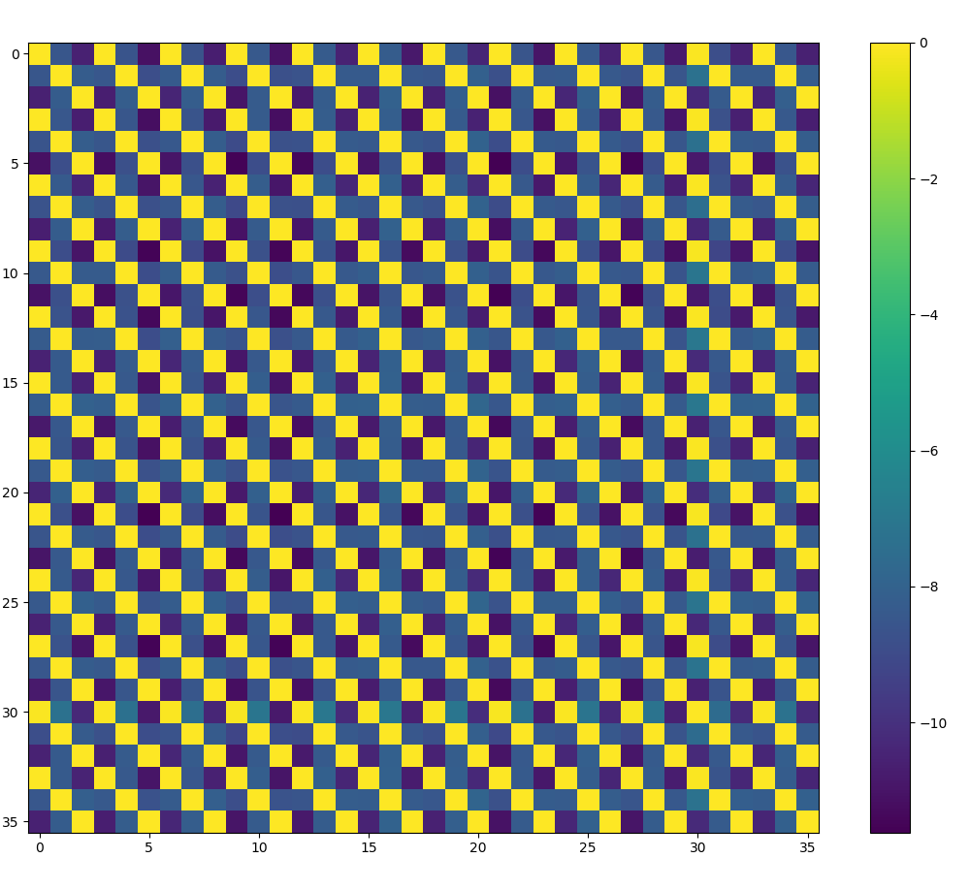
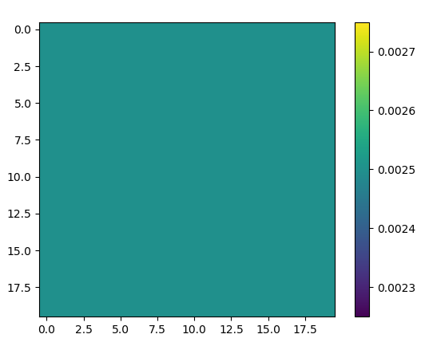
Encoder part
projection
head
lab_ratio:10% | mean dice
without pretrain | 0.857870738
pretrain using only iic | 0.842051685
pretrain using only contrast | 0.876779139
contrast + 1 * iic | 0.823987424
contrast + 3 * iic | 0.817107697
contrast + 5 * iic | 0.817107697
contrast +10 * iic | 0.797391653
e_{anc}
e_{pos}
e_{neg}
positive
normalized features
with reduced dim
p_{anc}
p_{pos}
p_{neg}
intemediate
features
projection
classifier

Slide 14
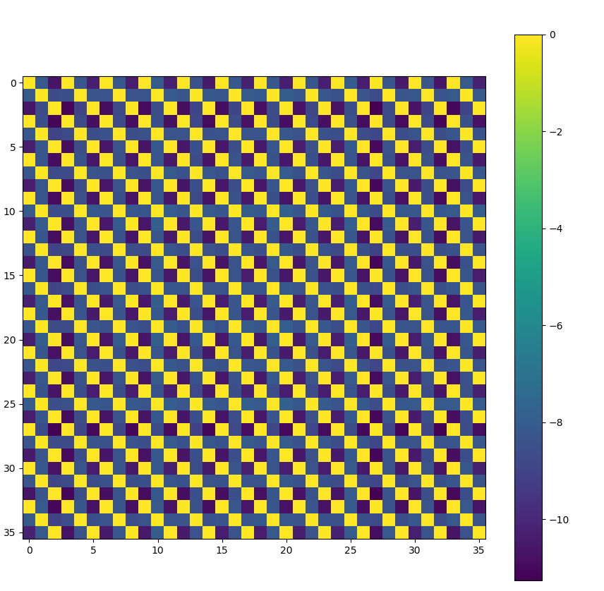
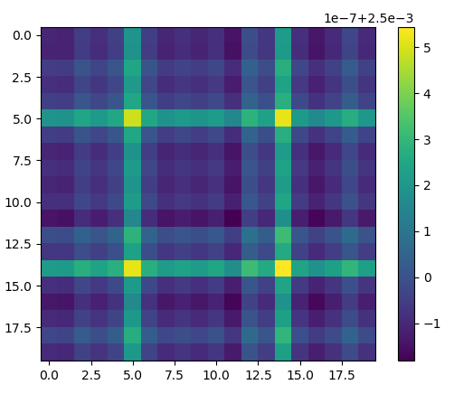
Encoder part
projection
head
lab_ratio:10% | mean dice
without pretrain | 0.857870738
pretrain using only iic | 0.842051685
pretrain using only contrast | 0.876779139
contrast + 1 * iic | 0.823987424
contrast + 3 * iic | 0.817107697
contrast + 5 * iic | 0.817107697
contrast +10 * iic | 0.797391653
e_{anc}
e_{pos}
e_{neg}
positive
normalized features
with reduced dim
p_{anc}
p_{pos}
p_{neg}
intemediate
features
projection
classifier

Slide 15
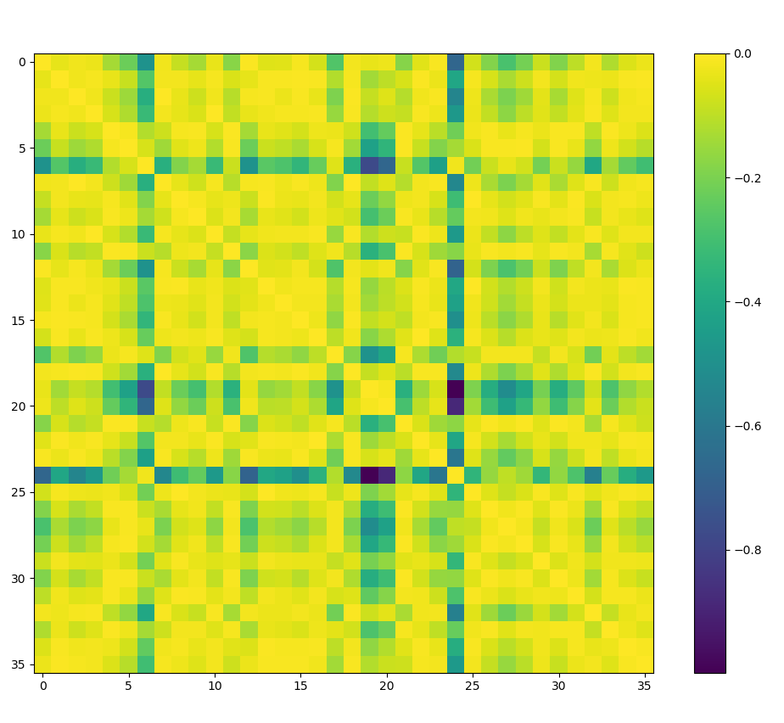
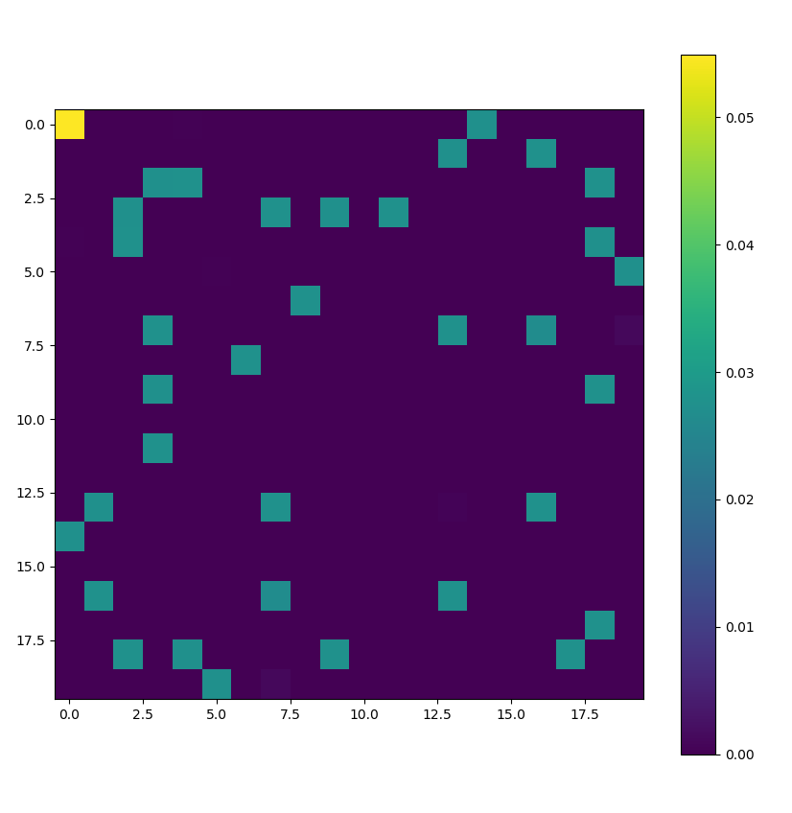
Encoder part
projection
head
lab_ratio:10% | mean dice
without pretrain | 0.857870738
pretrain using only iic | 0.842051685
pretrain using only contrast | 0.876779139
contrast + 1 * iic | 0.823987424
contrast + 3 * iic | 0.817107697
contrast + 5 * iic | 0.817107697
contrast +10 * iic | 0.797391653
e_{anc}
e_{pos}
e_{neg}
positive
normalized features
with reduced dim
p_{anc}
p_{pos}
p_{neg}
intemediate
features
projection
classifier

Slide 16
Conclusion 1
IIC loss in this sense does not do its proper jobs
Possible reasons:
1. temperature to adjust
2. num_clusters to adjust
3. reg_weight to adjust

Slide 17
Conclusion 1 extended
IIC loss in this sense does not do its proper jobs
Possible reasons:
1. temperature to adjust
2. num_clusters to adjust
3. reg_weight to adjust
 | lab_ratio:10% | mean dice
pretrain using only contrast | - | 0.876779139
contrast+5*iic | T=1.0 | 0.803779662
 | T=10 | 0.881362776
 | T=0.1 | 0.818282465
contrast+10*iic | T=1.0 | 0.797391653
 | T=10 | 0.877858798
 | T=0.1 | 0.83264641

Slide 18
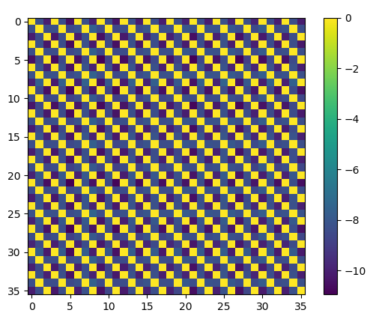
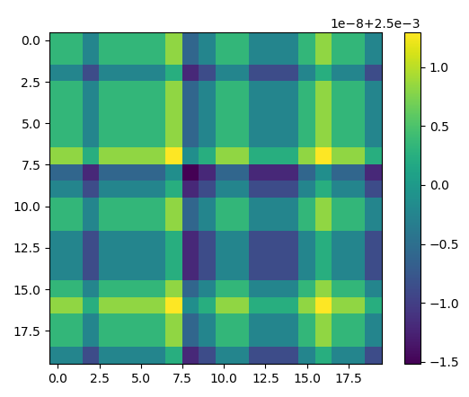
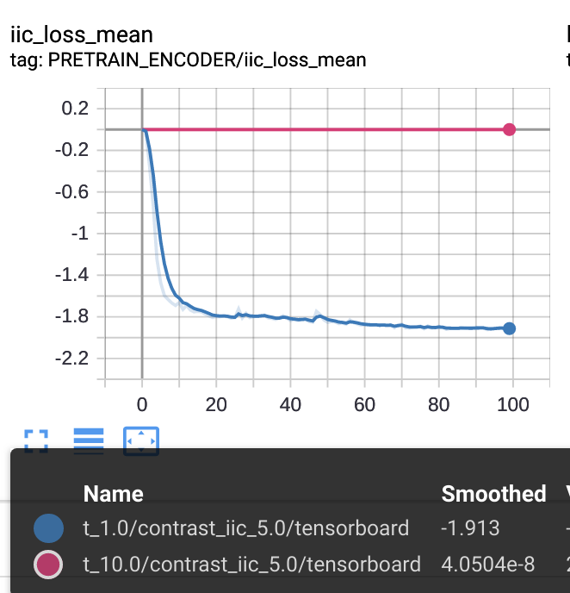
Conclusion 1 extended
IIC loss in this sense does not do its proper jobs
Possible reasons:
1. temperature to adjust
response:
large T works, but the loss did not converge
 | lab_ratio:10% | mean dice
pretrain using only contrast | - | 0.876779139
contrast+5*iic | T=1.0 | 0.803779662
 | T=10 | 0.881362776
 | T=0.1 | 0.818282465
contrast+10*iic | T=1.0 | 0.797391653
 | T=10 | 0.877858798
 | T=0.1 | 0.83264641

Slide 19
Conclusion 1
IIC loss in this sense does not do its proper jobs
Possible reasons:
1. temperature to adjust
2. num_clusters to adjust
response:
N with a larger value is better, but the gap is very large.
 | lab_ratio:10% | mean dice
pretrain using only contrast | - | 0.876779139
contrast+5*iic | N=10 | 0.803779662
 | N=20 | 0.814759254
contrast+10*iic | N=10 | 0.797391653
 | N=20 | 0.81805857

Slide 20
Encoder part
projection
head
lab_ratio:10% | mean dice
without pretrain | 0.857870738
pretrain using only iic | 0.842051685
pretrain using only contrast | 0.876779139
contrast + 1 * iic | 0.823987424
contrast + 3 * iic | 0.817107697
contrast + 5 * iic | 0.817107697
contrast +10 * iic | 0.797391653
e_{anc}
e_{pos}
e_{neg}
positive
normalized features
with reduced dim
p_{anc}
p_{pos}
p_{neg}
intemediate
features
projection
classifier

Slide 21
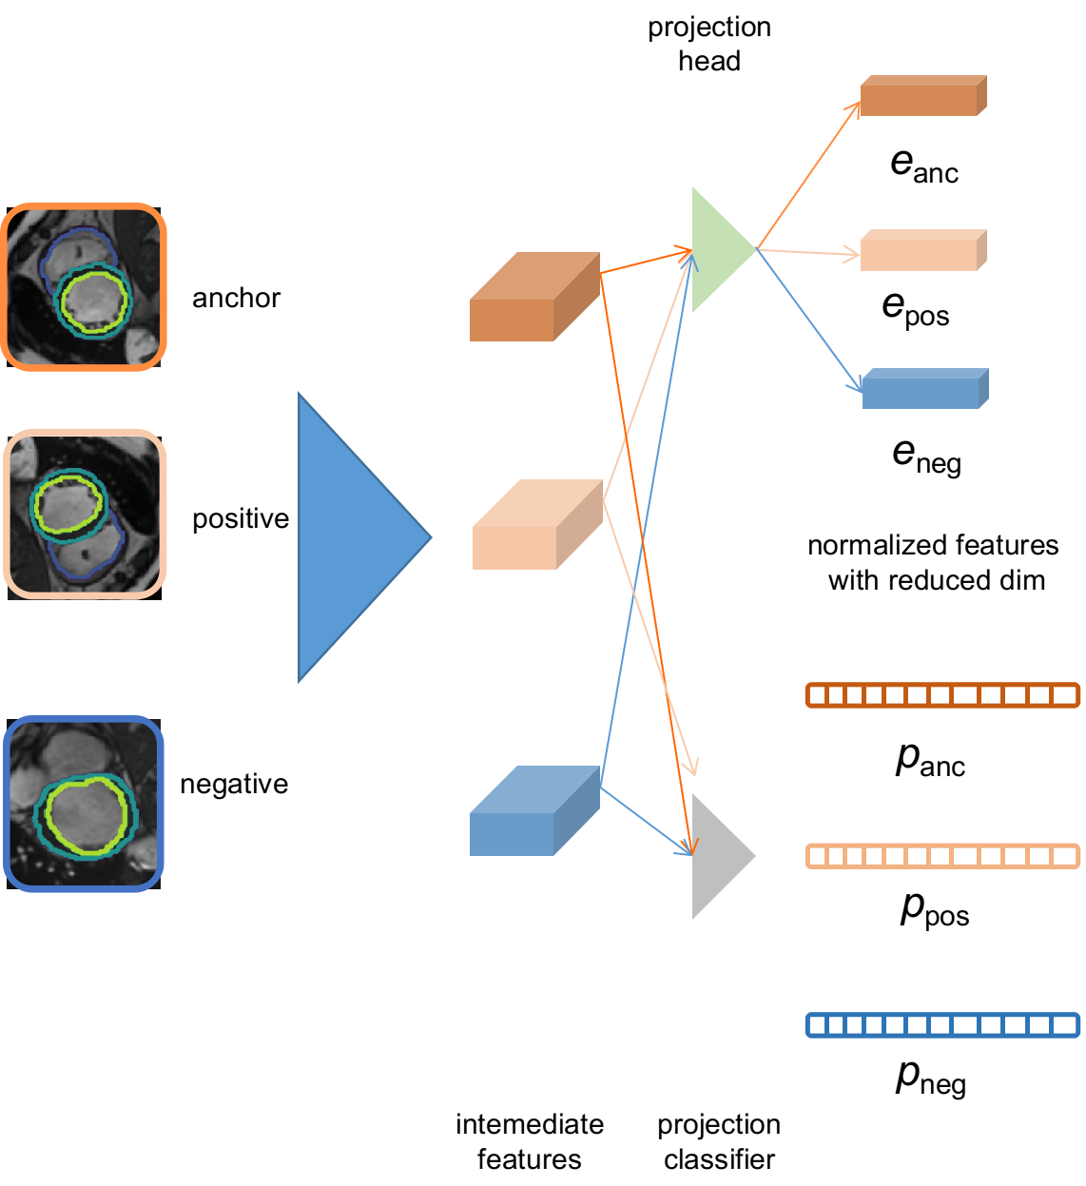
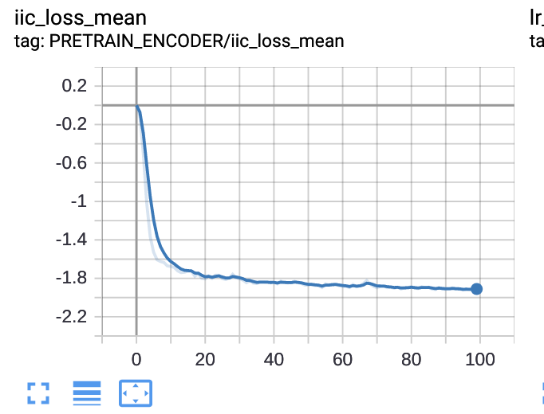
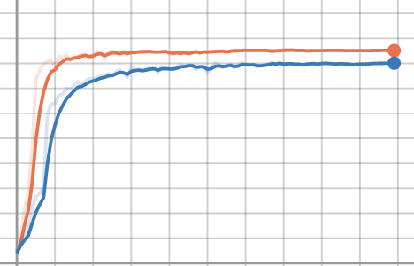
Problems to discuss
Does IIC work in this case?
IIC
baseline
IIC
why?
Augmentation is not enough so that the enc_code
is not scattered
-> try more augmentations

Slide 22
0802
Some experimental results
Cluster effect on feature space

Slide 23
Encoder part
projection
head
2% of labeled data
e_{anc}
data augment | simple | complex
without pretrain | - | 74.08
pretrain encoder | 83.25 | 80.59
pretrain enc+dec | 81.71 | 78.26
e_{pos}
e_{neg}
2% of labeled data
positive
batch size | 18 | 75
without pretrain | 76.3 | -
pretrain encoder | 83.25 | 83.31
pretrain enc+dec | 81.71 | -
normalized features
with reduced dim
p_{anc}
10% of labeled data
p_{pos}
Contrast on | partition | patient | both
without pretrain | 86.26
pretrain encoder | 87.71 | - | -
pretrain enc+dec | 87.46 | 87.11 | 87.24
p_{neg}
intemediate
features
projection
classifier

Slide 24
Encoder part
2% of labeled data
projection
head
clus. num\bs | 18 | 75
10 | 61.73 | 76.92
50 | 59.40 | 66.39
80 | 64.23 | 67.33
baseline | 75.67
e_{anc}
e_{pos}
5% of labeled data
e_{neg}
clus. num\bs | 18 | 75
10 | 76.29 | 83.34
50 | 75.38 | 76.78
80 | 75.35 | 76.24
baseline | 83.80
positive
normalized features
with reduced dim
p_{anc}
10% of labeled data
p_{pos}
clus. num\bs | 18 | 75
10 | 82.09 | 86.52
50 | 81.66 | 84.29
80 | 82.29 | 83.35
baseline | 85.57
p_{neg}
intemediate
features
projection
classifier

Slide 25
Encoder part
2% of labeled data
projection
head
 | 1 | 3 | 5 | 10
Cont+IIC | 83.19 | 82.99 | 82.39 | 83.65
only Cont | 83.09
only IIC | 76.92
baseline | 75.67
e_{anc}
e_{pos}
5% of labeled data
e_{neg}
 | 1 | 3 | 5 | 10
Cont+IIC | 85.50 | 86.26 | 85.49 | 85.70
only Cont | 85.56
only IIC | 83.34
baseline | 83.80
positive
normalized features
with reduced dim
p_{anc}
10% of labeled data
p_{pos}
 | 1 | 3 | 5 | 10
Cont+IIC | 88.31 | 87.84 | 87.56 | 86.54
only Cont | 87.74
only IIC | 86.52
baseline | 85.57
p_{neg}
intemediate
features
projection
classifier

Slide 26
What is going on feature space
projection
head
e_{anc}
e_{pos}
e_{neg}
positive
normalized features
with reduced dim
p_{anc}
p_{pos}
projection
classifier
Feature space
p_{neg}

Slide 27
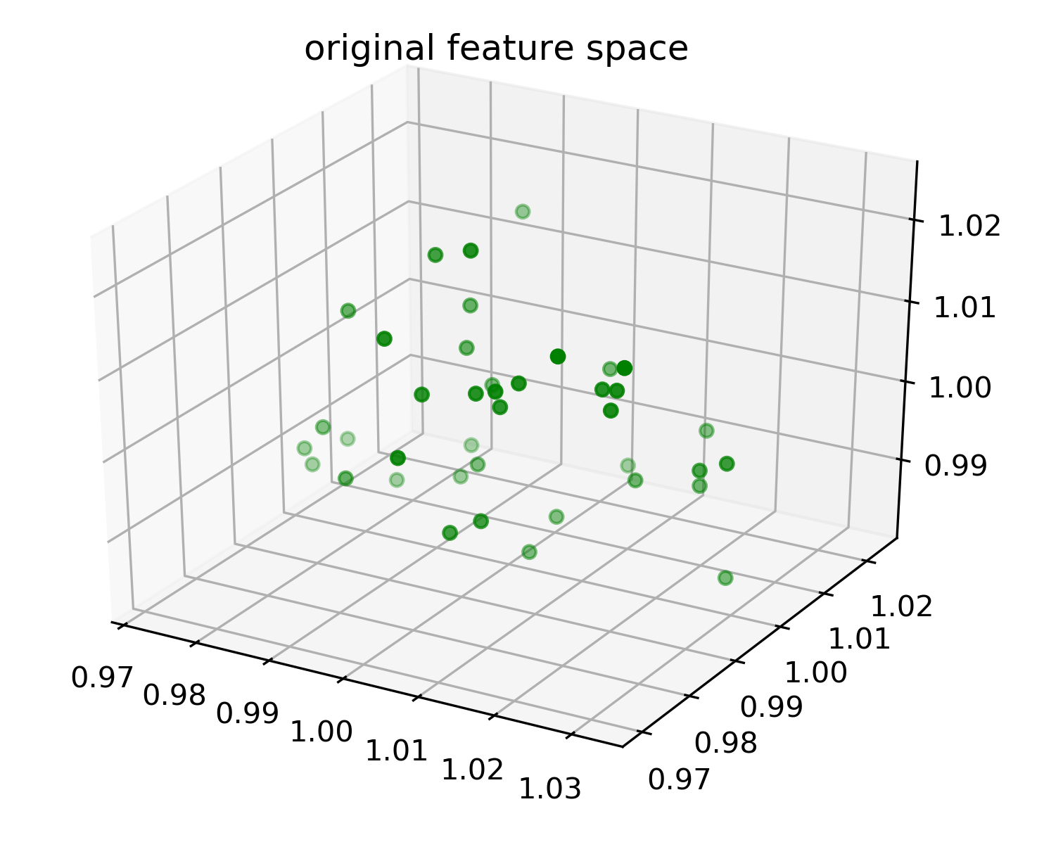
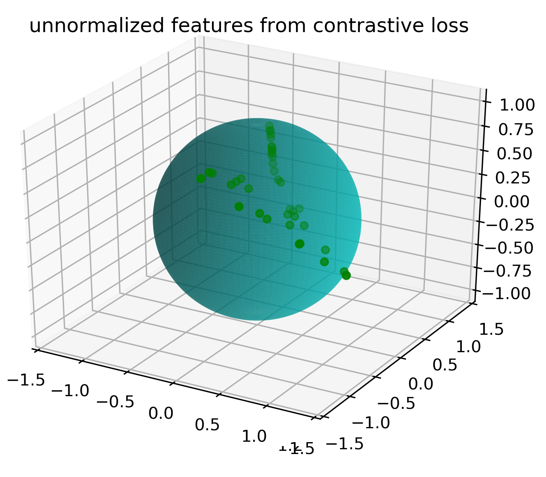
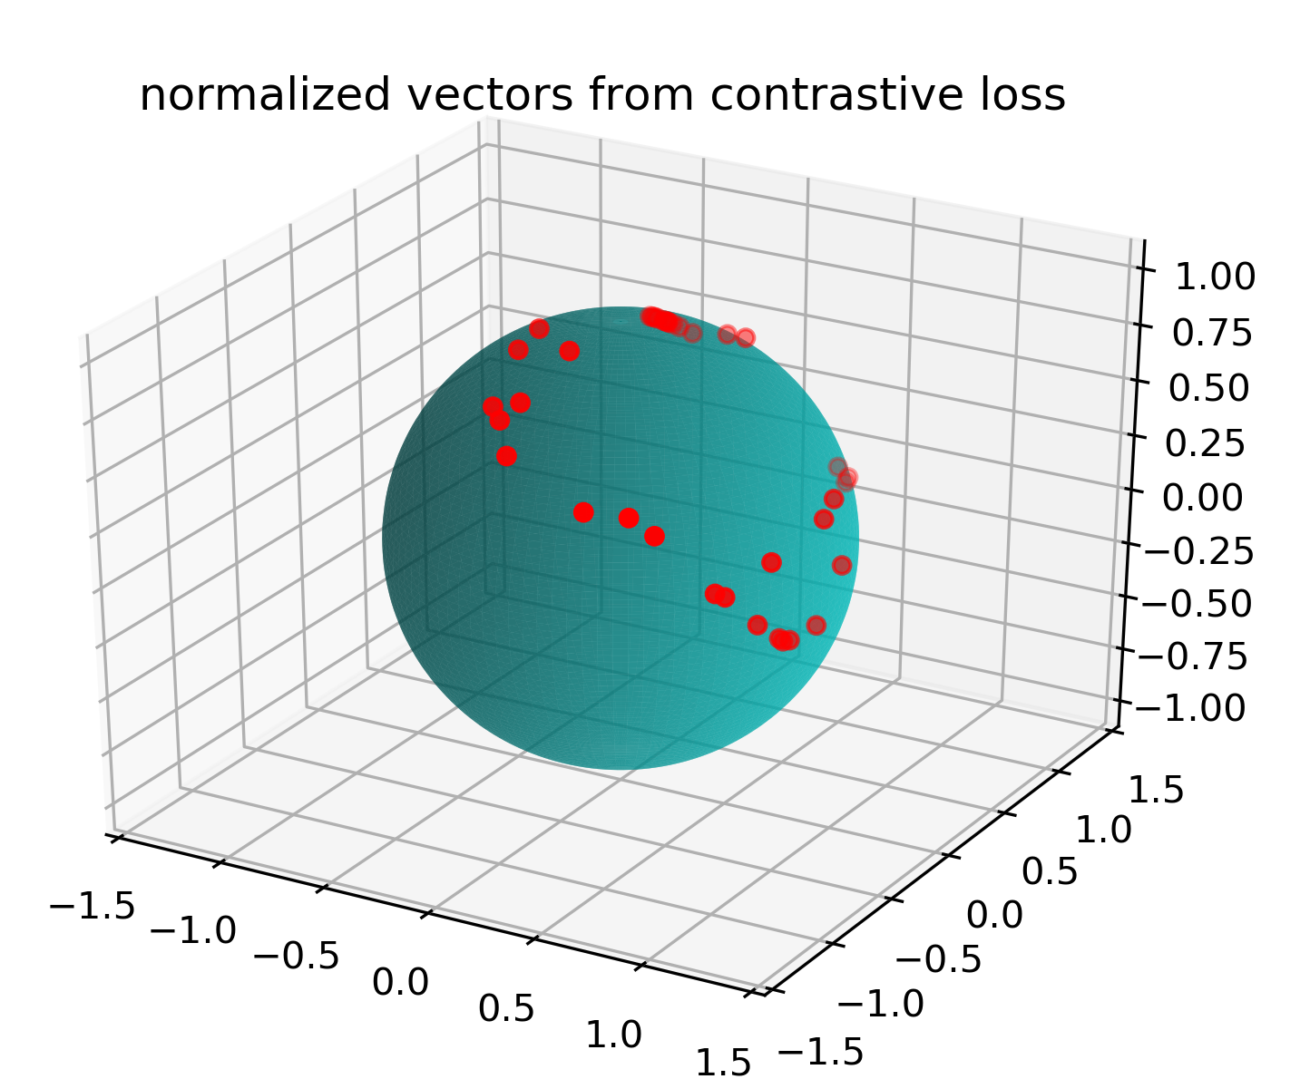
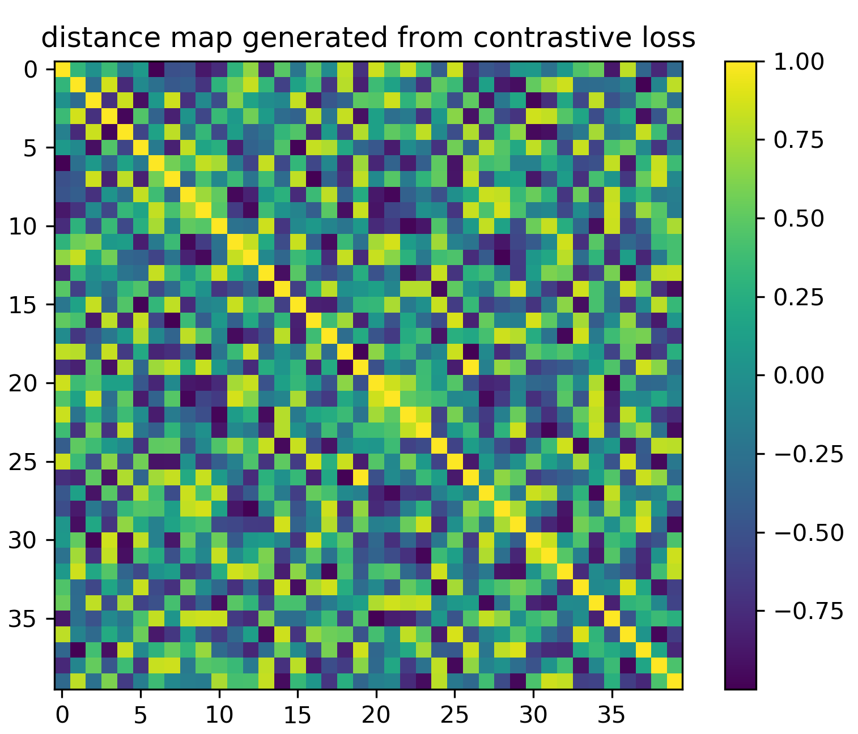
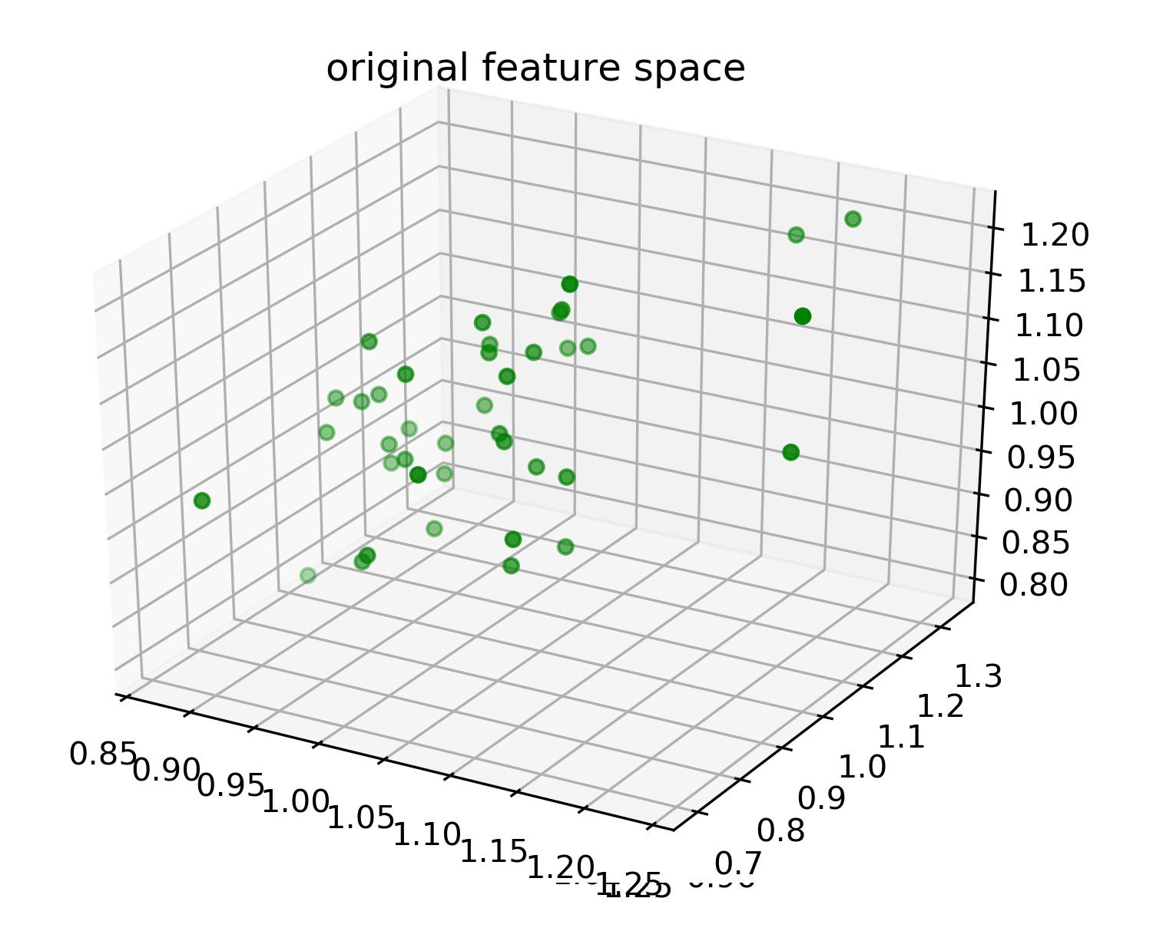
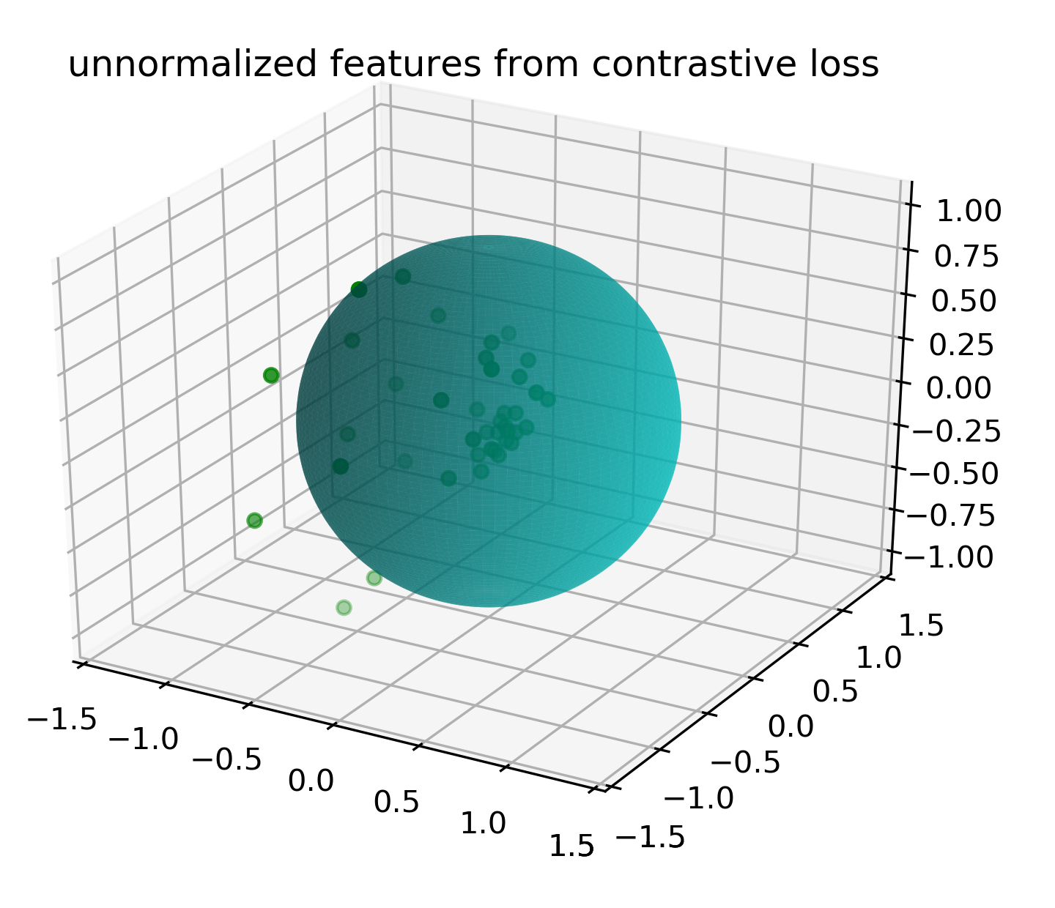
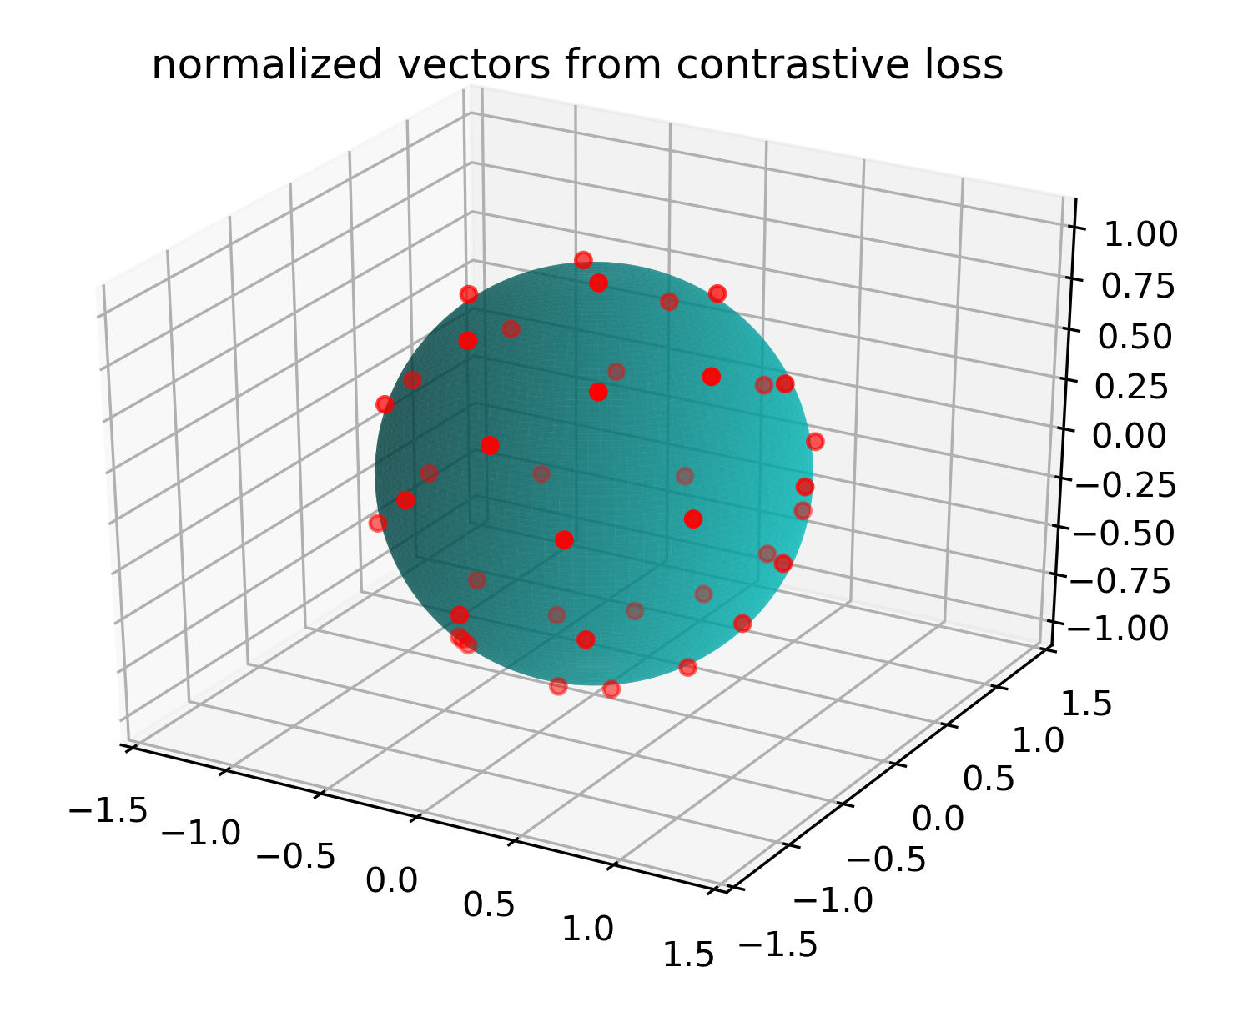
What is going on feature space
projection
head
Feature space
vector space
normalized vector space
v
e

Slide 28
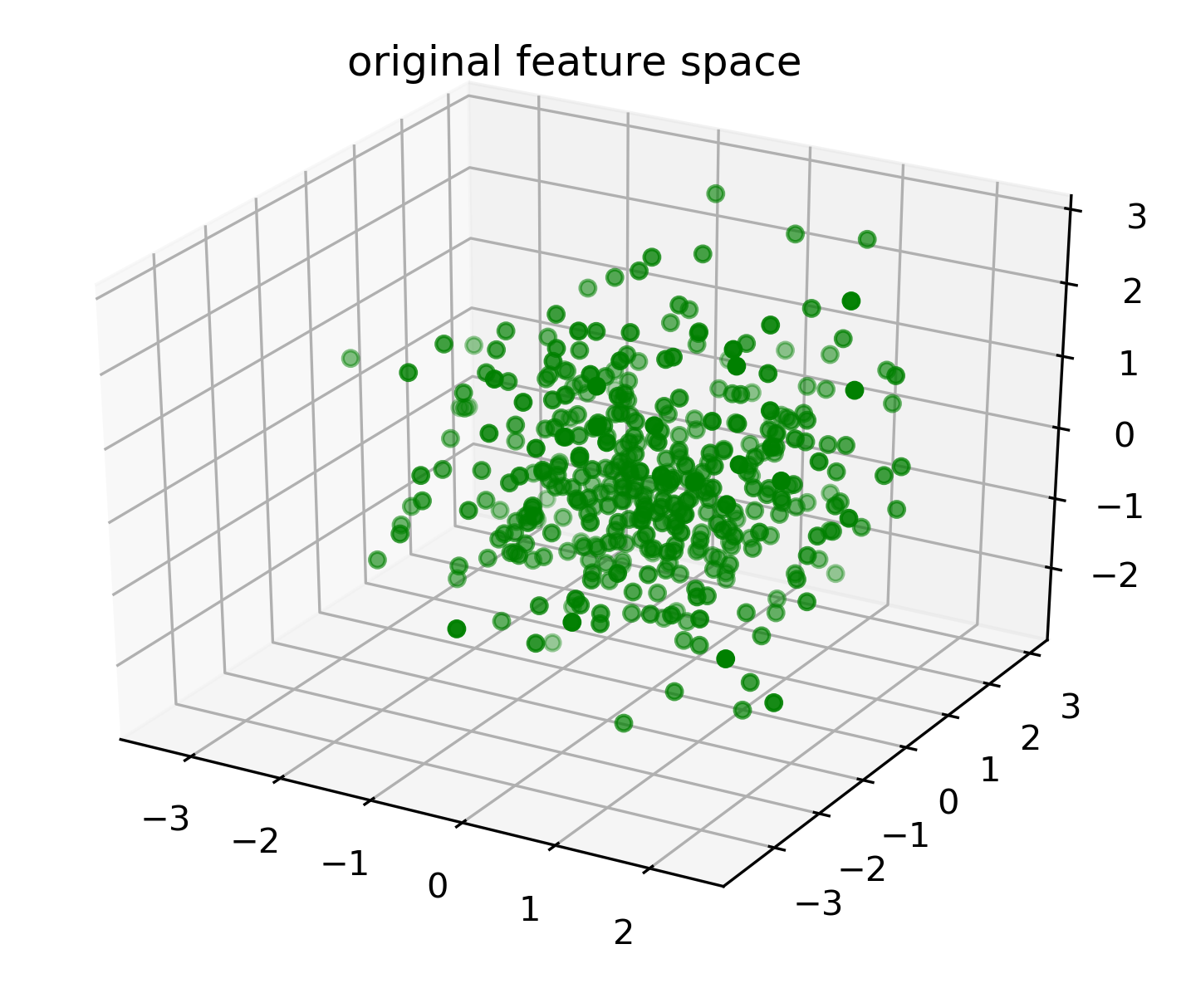
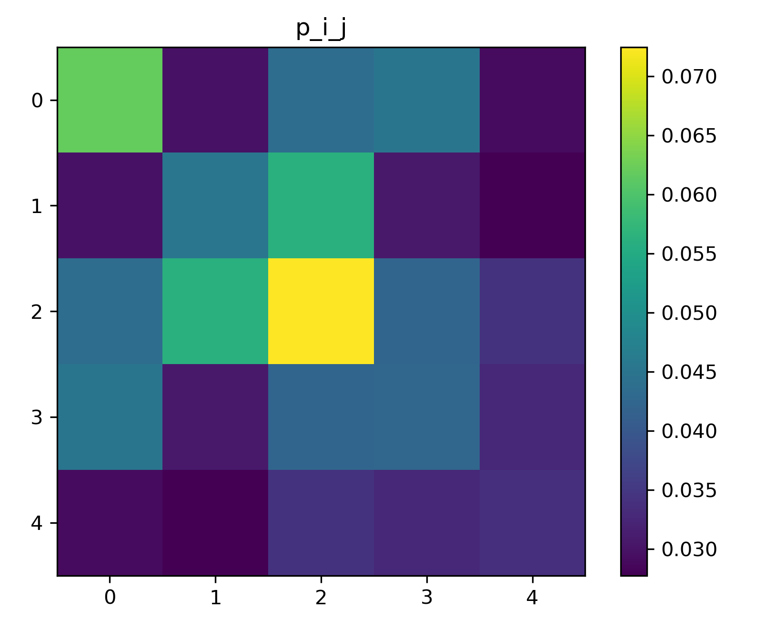
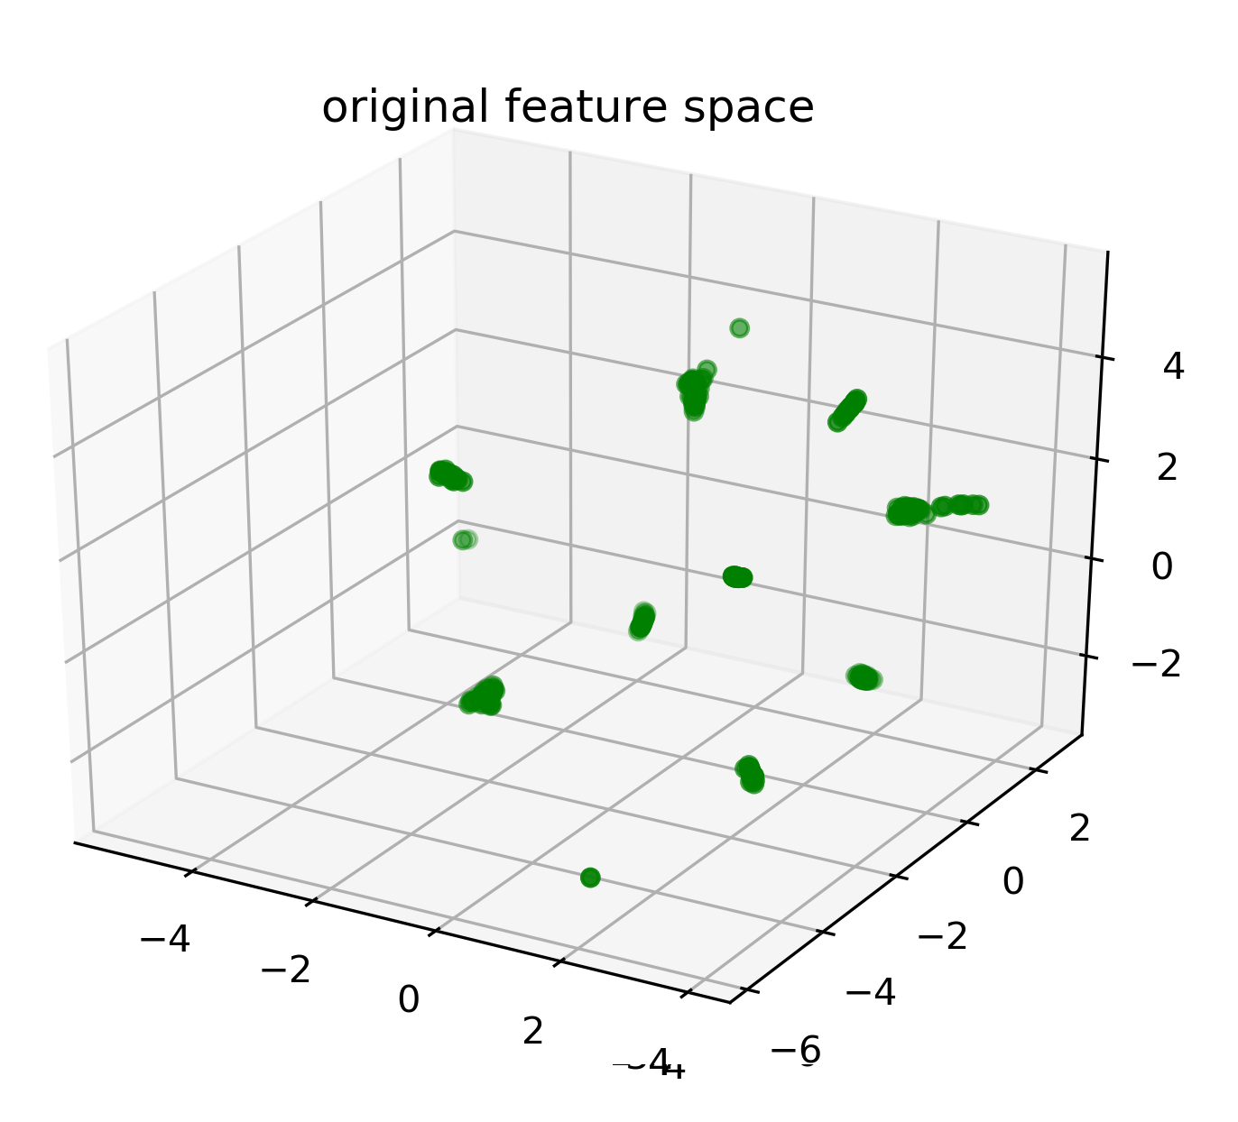
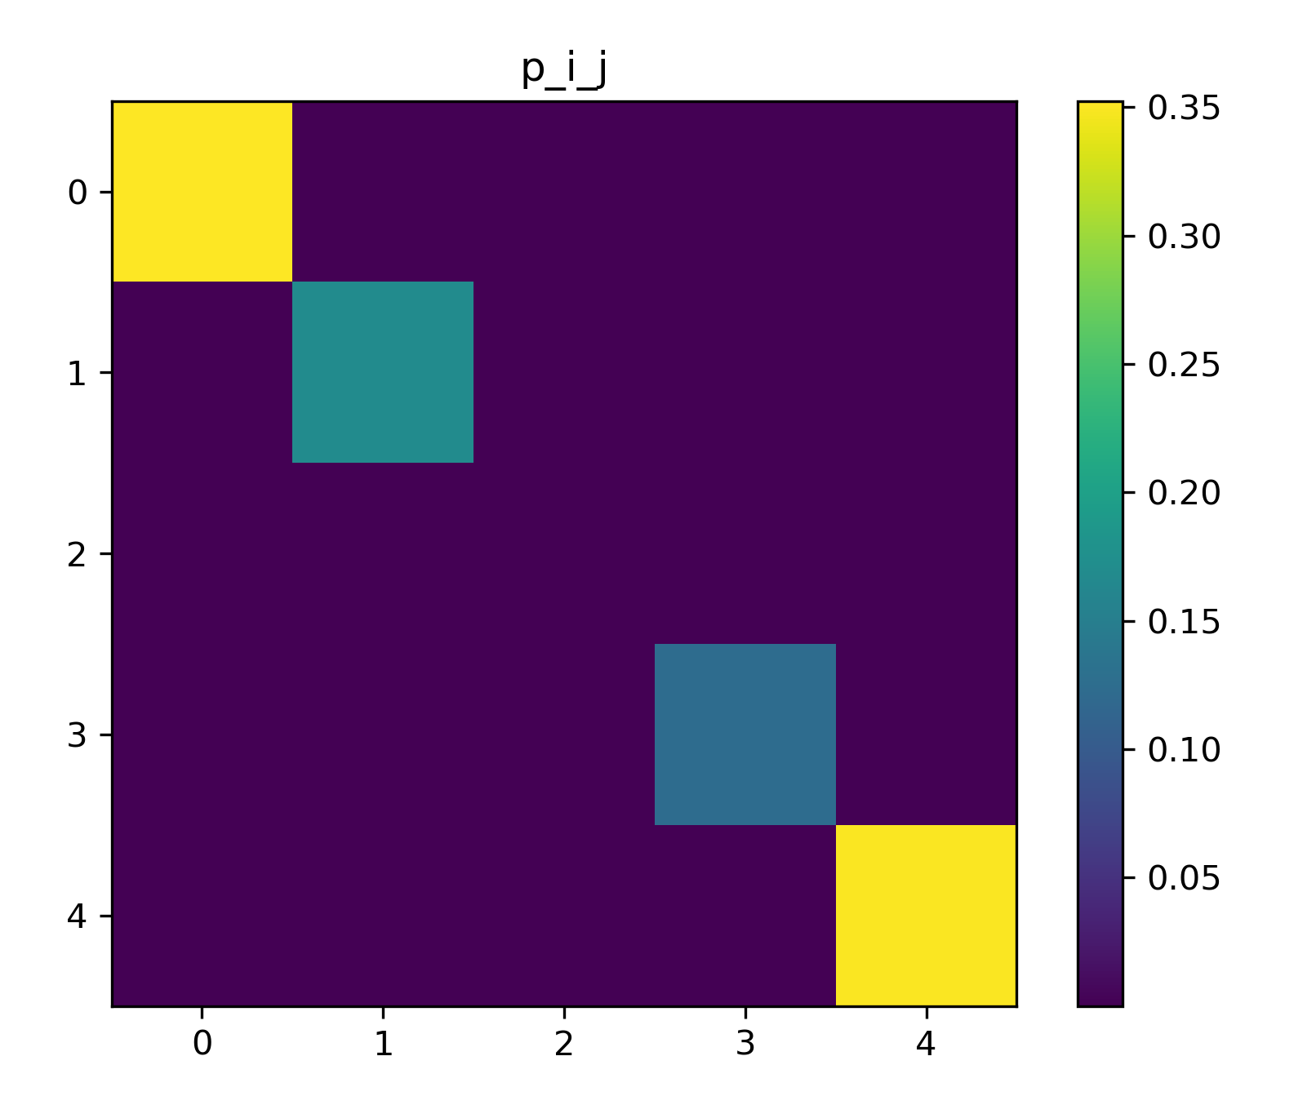
What is going on feature space
classification
head
Feature space
probability space
p

Slide 29
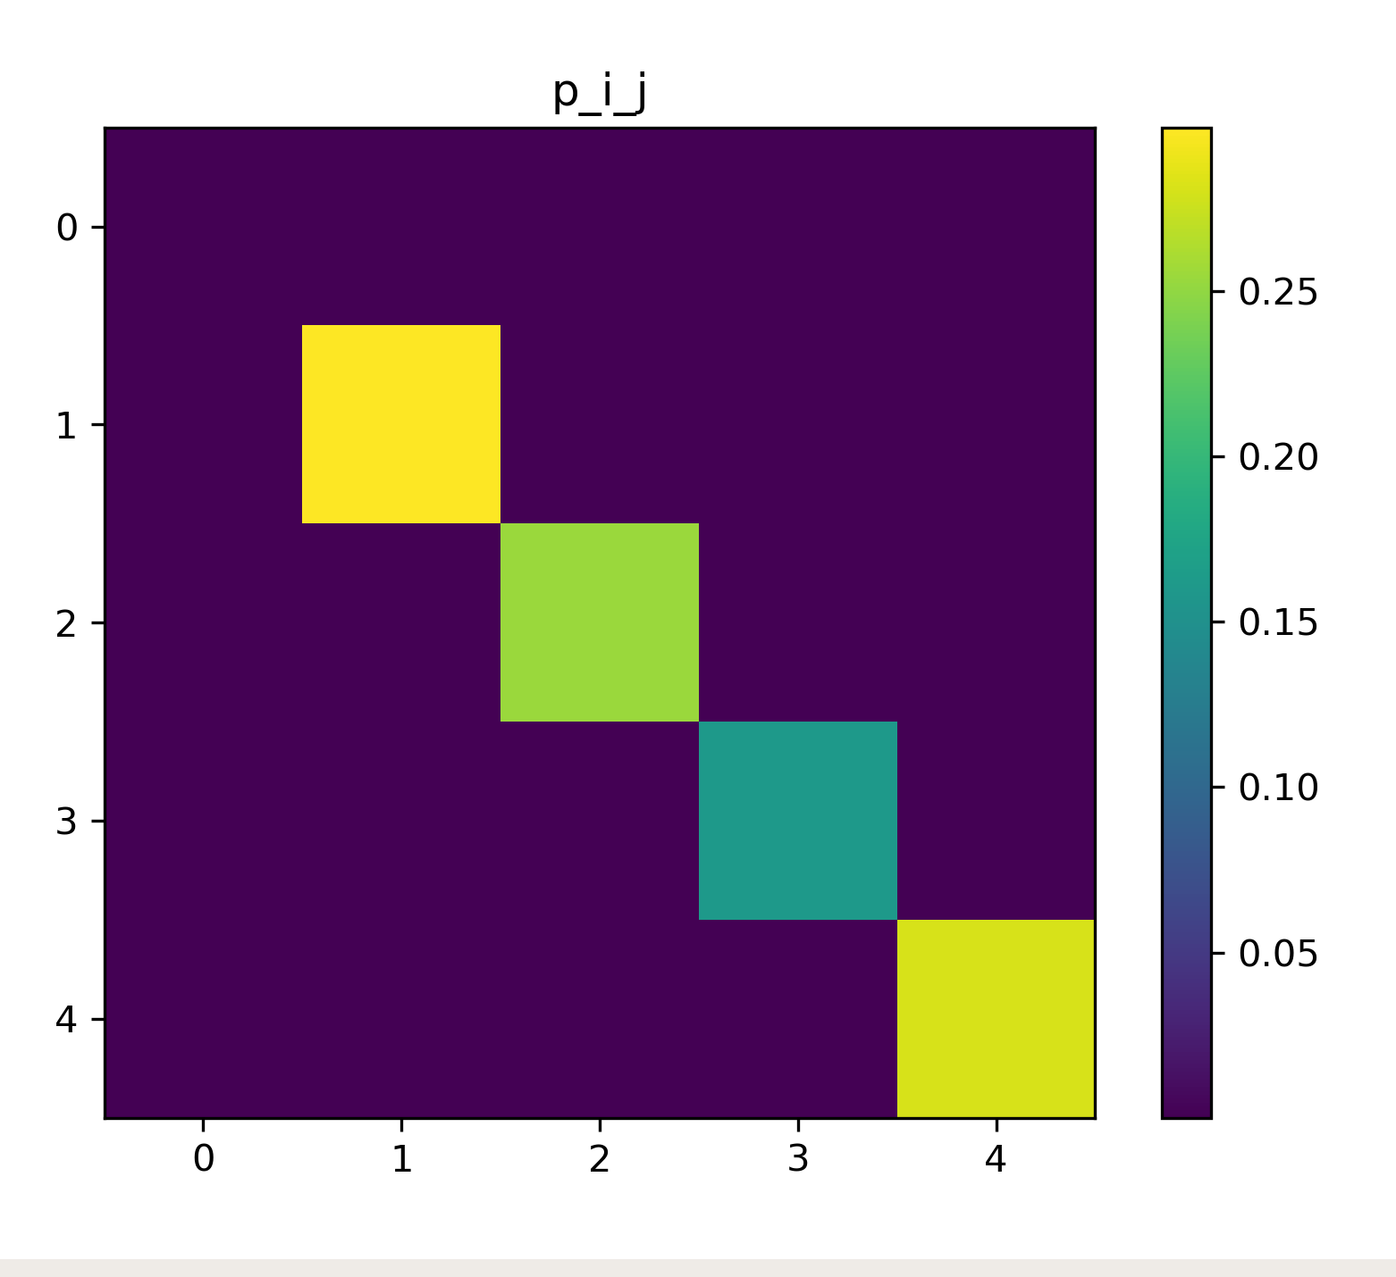
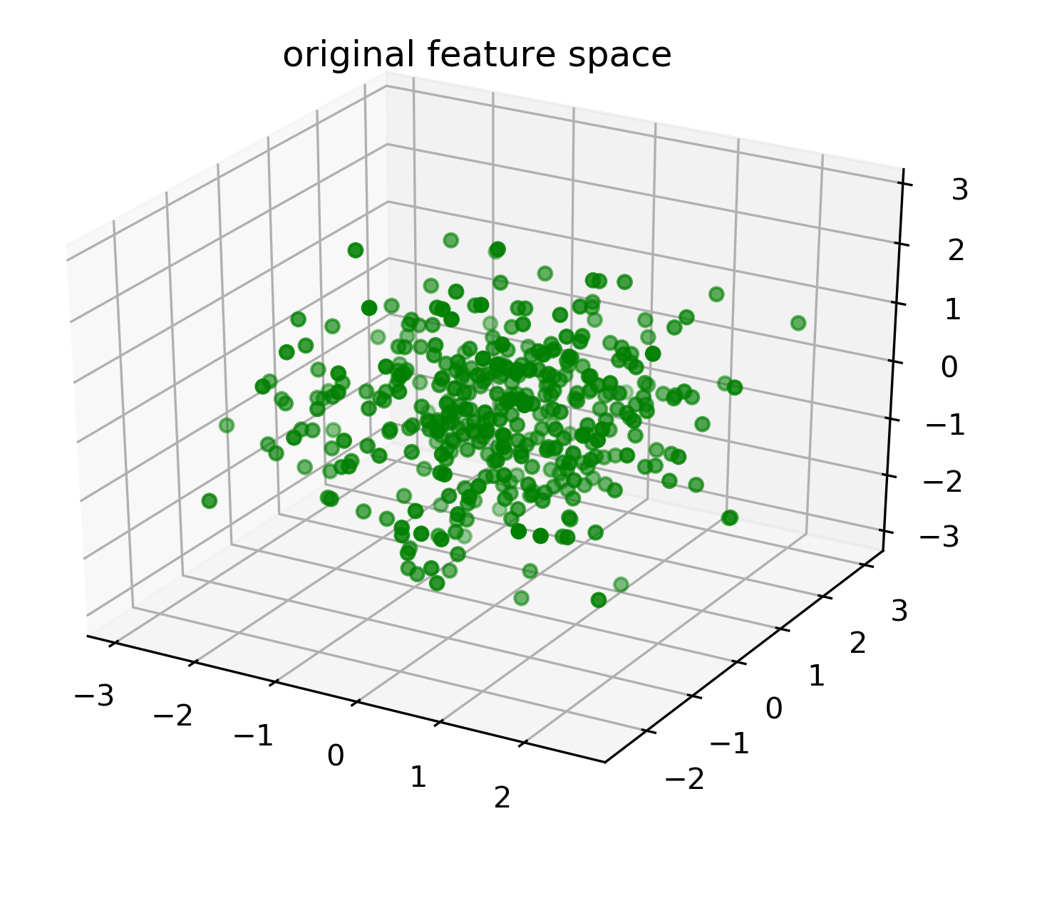
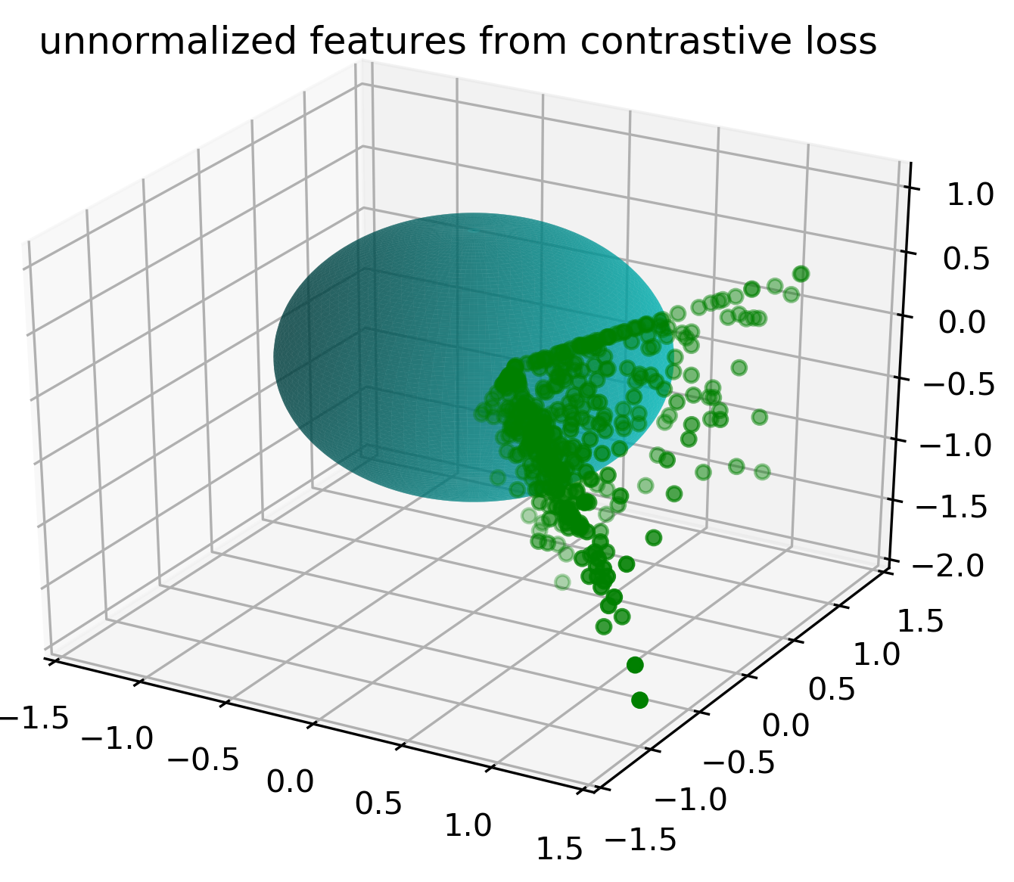
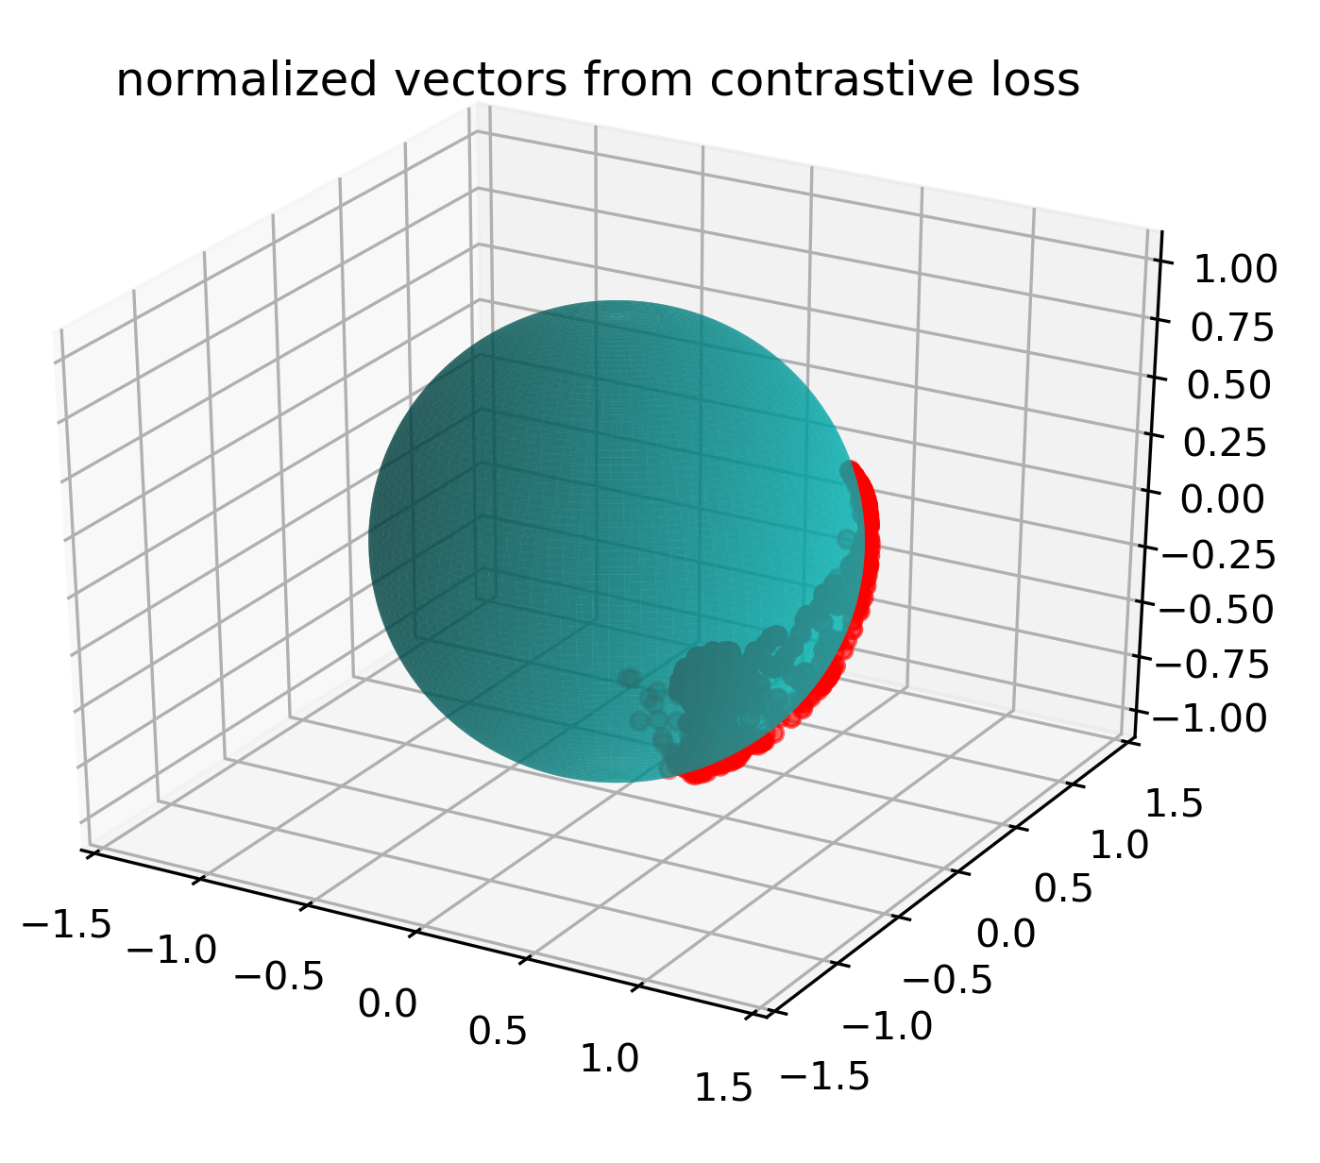
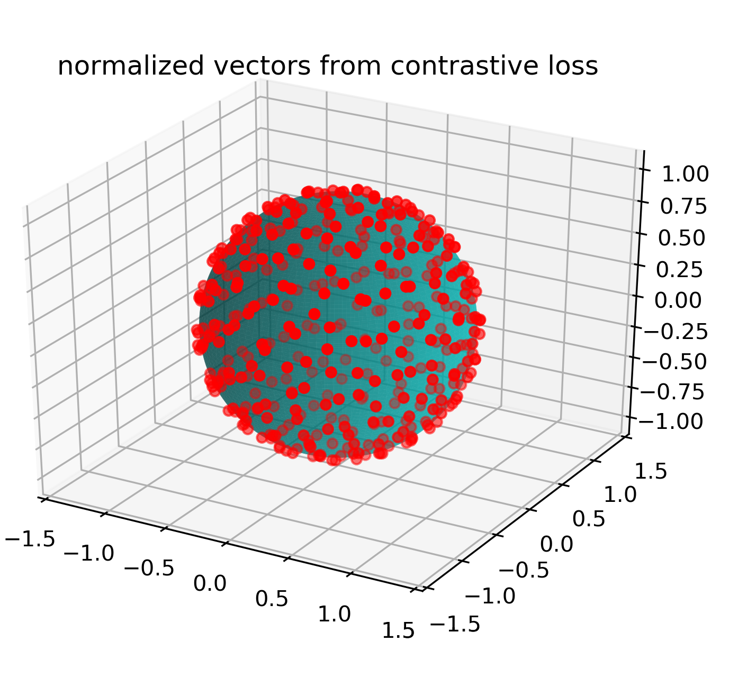



So what?
projection
head
Feature space
vector space
normalized vector space
v
e

Slide 30
what has been done for the next
1. I have done an extra experiment on the assumption on CIFAR10 dataset to see if it works.
2. I am going to run the segmentation to check

Slide 31
Parameters to check
For contrastive learning
encoder position
encoder type: linear or mlp
decoder position
decoder type: linear or mlp
gradient update for encoder
For IIC learning
encoder position
encoder type: linear or mlp
num_cluster
num_subheads
decoder position
decoder type: linear or mlp
gradient update for encoder
num_cluster
num_subheads

Slide 32

IIC+contrastive learning on cifar10
num_cluster: 10
num_subhead: 10
method | acc
Cross entropy | 95.36
Simclr | 92.74
simclr + 0.0001 IIC | 92.95
simclr + 0.001 IIC | 92.89
simclr + 0.01 IIC | 92.90
simclr+ 0.1 IIC | 92.85
This improvement validates that the IIC can slightly improve the performance

Slide 33






IIC with ACDC dataset
p_{anc}
p_{pos}
positive
projection
classifier
p_{neg}
 | 10% data
only IIC | 84.29%
only Contrast | 86.71%
baseline | 81.00%
Feature space

Slide 34



num_subheads vs num_clusters on ACDC
10% data
only IIC
contrast+0.1 x IIC
contrast+1.0 x IIC
Baseline: without pretraining 85.39%
only using contrastive 87.35%

Slide 35



num_subheads vs num_clusters on ACDC
2% data
only IIC
contrast+0.1 x IIC
contrast+1.0 x IIC
Baseline: without pretraining 77.17%
only using contrastive 81.43%

Slide 36


num_subheads vs num_clusters on ACDC
1% data
only IIC
contrast+0.1 x IIC
contrast+1.0 x IIC
Baseline: without pretraining 61.93%
only using contrastive 72.82%

Slide 37

0809 feature position: encoder
acc | baseline | conv3 | conv4 | conv5
10% | 81.00 | 85.13 | 86.47 | 87.59
2% | 40.40 | 63.78 | 73.38 | 73.32
1% | 31.07 | 48.26 | 62.94 | 64.93

Slide 38

What is going on feature space
projection
head
e_{anc}
e_{pos}
e_{neg}
positive
normalized features
with reduced dim
Feature space

Slide 39

What is going on feature space
projection
head
e_{anc}
e_{pos}
e_{neg}
positive
normalized features
with reduced dim
Feature space

Slide 40
IIC decoder training vs contrastive decoder training
projection
head
e_{anc}
e_{pos}
e_{neg}
positive
normalized features
with reduced dim
IIC (T(p(x)),p(T(x)) )
Feature space

Slide 41





decoder features trained with contrastive loss

Slide 42







decoder features trained with IIC loss

Slide 43








A new IIC loss based on small patches
IIC loss = IIC ( , ) +
IIC ( , )
IIC loss = IIC ( , ) +
IIC ( , )
IIC loss = IIC ( , ) +
IIC ( , ) +
IIC ( , ) + ...

Slide 44






decoder features trained with IIC loss

Slide 45
bast case I can get for the ACDC dataset
baseline | IIC series |  |  |  | Contrastive series
81.00 | encoder | decoder | ps | dice | encoder | decoder
 | linear | X |  | 82.13 | linear | x | 86.95
 | mlp | X |  | 81.20 | mlp | x | 86.88
 | linear | linear | all | 82.97 | mlp | linear | 87.61
 | linear | mlp | all | 81.13 | mlp | mlp | 87.02
 | linear | mlp | 32(0) | 82.72
 | linear | mlp | 32(1) | 82.26

